Slide 1
Relevant Projects
Robert Sanders

Slide 2
My Projects
I have done several projects in the Computer Science Field
Building two Computers
Constructing an live feed baseball led scoreboard
KnowItAll Sports Database

Slide 3
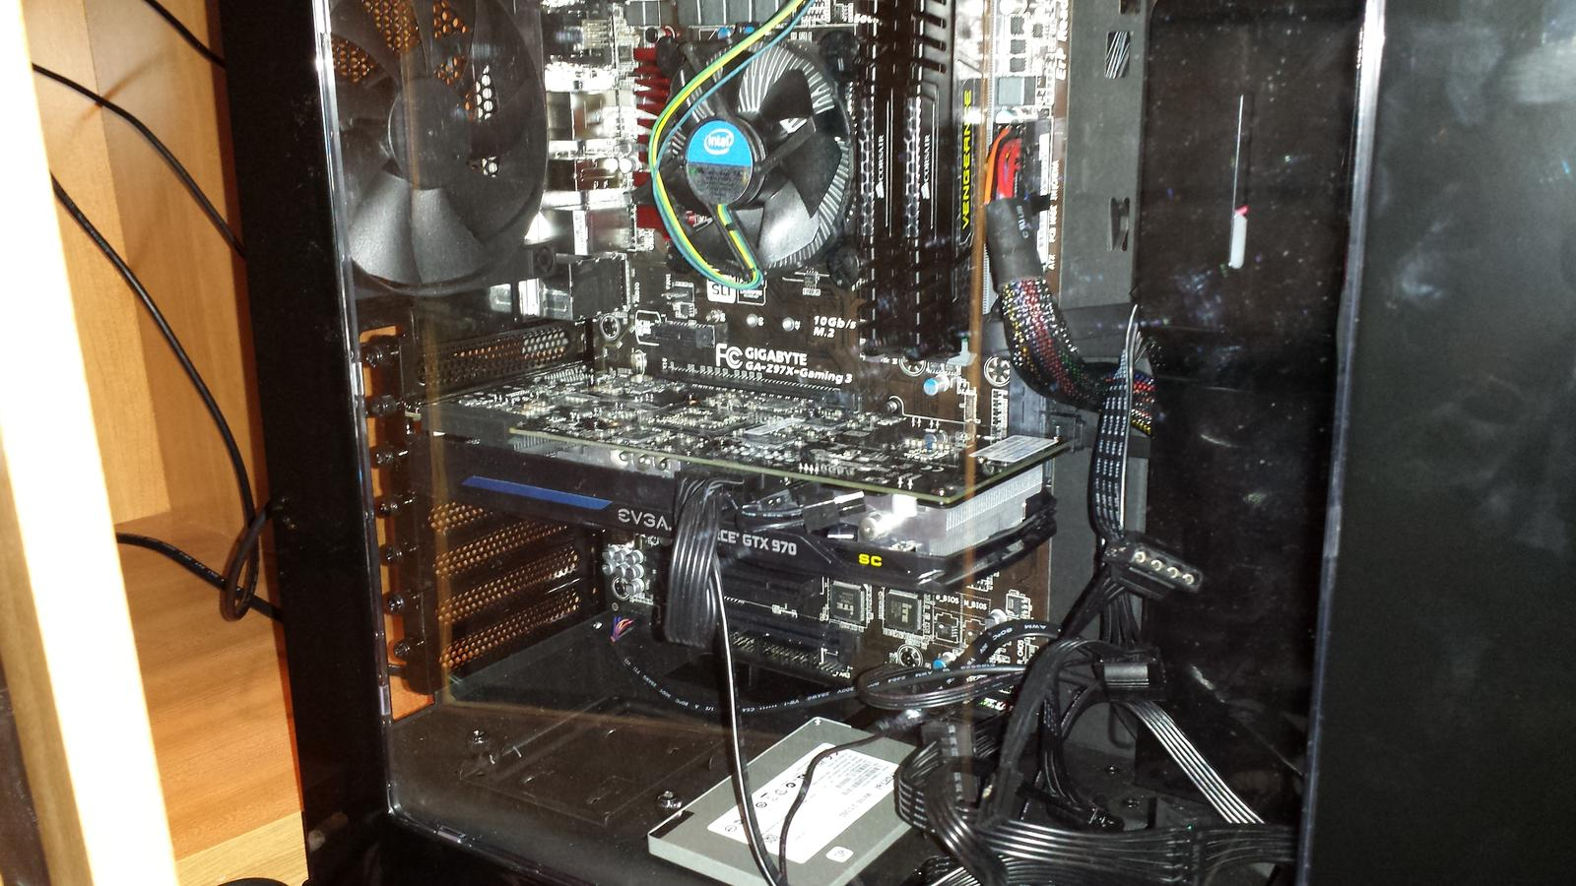
Computer Construction
Built a desktop computer for myself, to having video game capabilities
Part List: here
Bought parts at Micro Center
Assembled computer over a night and the next morning, by following steps I had learned online

Slide 4
Takeaways
Learned how interesting Computers are, and that I wanted to learn more about how they worked
Remembered having issues with cable connections the next morning, and had to rewire the power button cable
Learned about the architecture of the computer, and how each part operates with each other
Building a computer in this manner was much cheaper than buying a preassembled desktop from a store
Wanted to build another computer

Slide 5
Second Computer
Built for father as a workstation
Part list: here

Slide 6
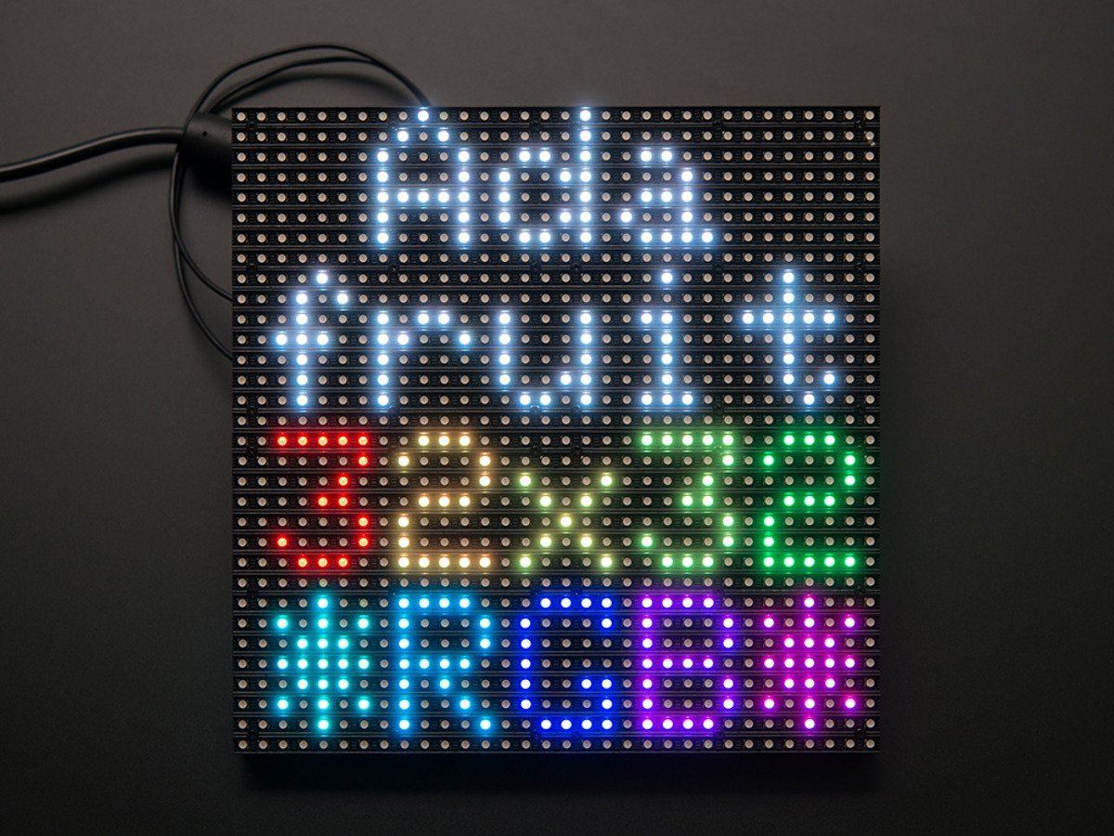
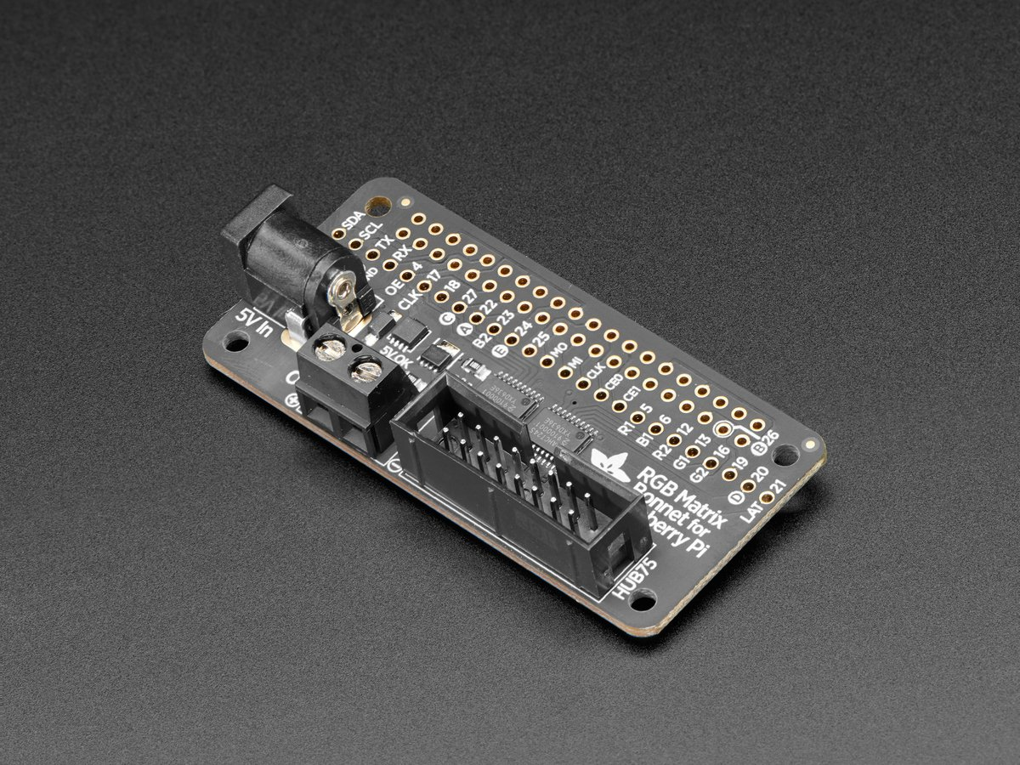
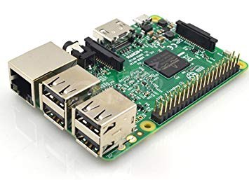
Baseball Scoreboard
I’m a huge baseball fan
Saw a project to build an led scoreboard online
Involved the following parts:
Raspberry pi 3 Adafruit RGB Matrix 32 X 32 Adafruit RGB Matrix Bonnet

Slide 7
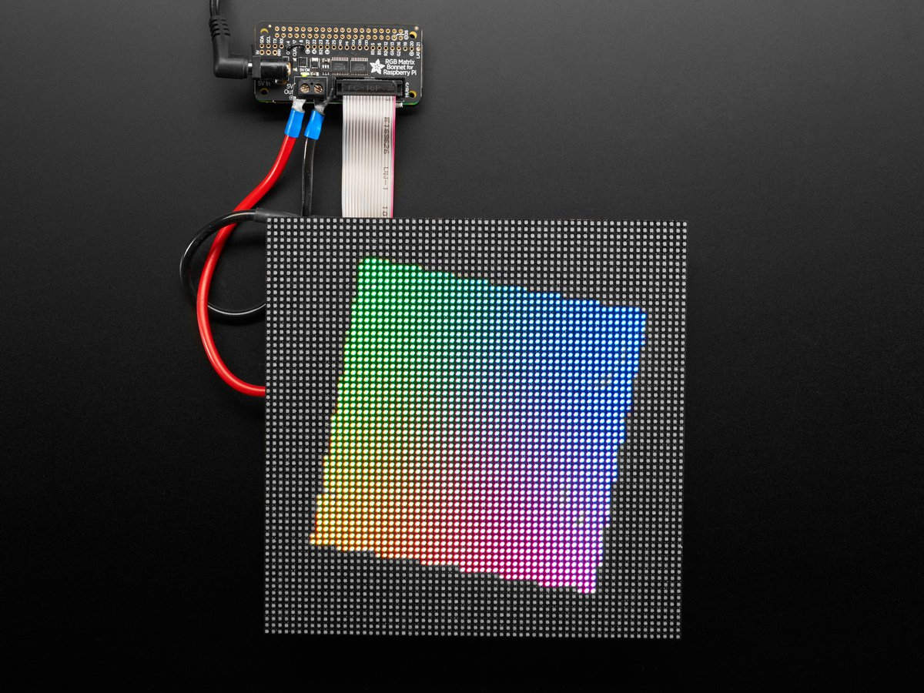

Slide 8
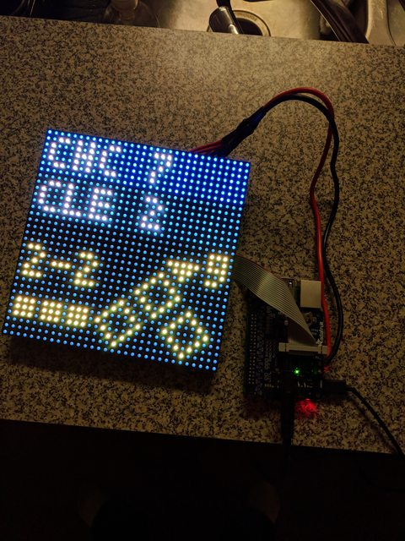

Slide 9
Build Process
Attached the RGB matrix bonnet to the raspberry pi, connected the cables from the matrix board, and connected it to the bonnet with a ribbon cable, power cable connecting to a Molex header, and a few power cables.
On raspberry pi, I cloned a GitHub repository made for displaying the baseball scores in a visible format on the matrix board.
The GitHub code also scraped a website for the live scores
Configured on Raspberry Pi to run the scoreboard on startup by moving a text file to the system folder, and running some commands

Slide 10

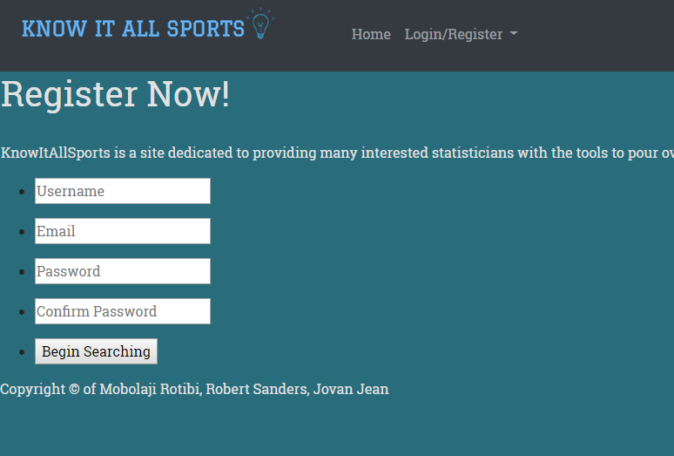
Database
Created a website to view sports statistics
Designed with a team of two other people
Built database schema using MySQL Workbench
Teammates built front end website
Created a login system

